Slide 1
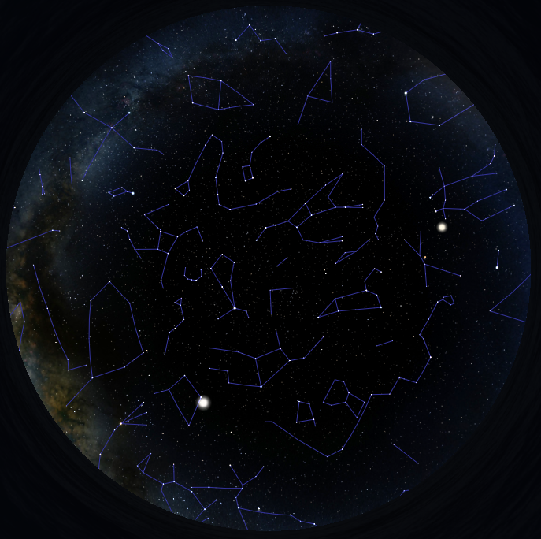
What’s Up?
Highlighting the Near
and Deep Sky
June 1 - 30, 2023

Slide 2
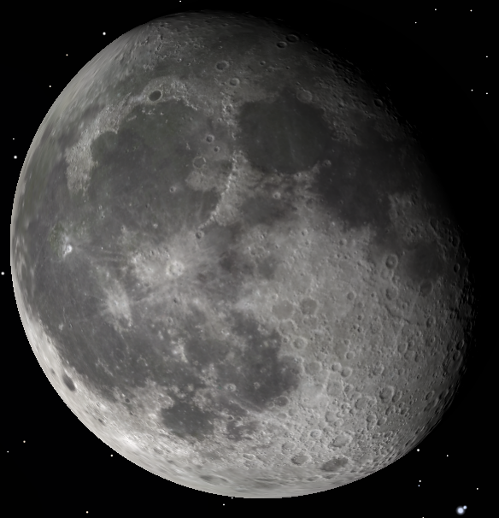
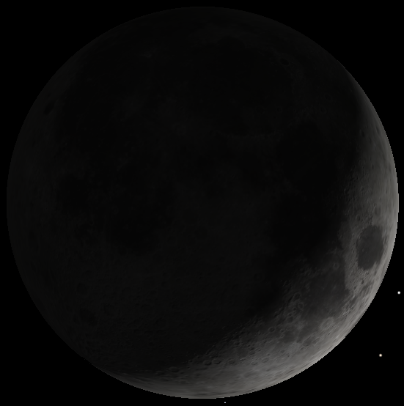
Moon Phases and Apsides
June 2023
Moon Phases:
Sat., 3rd – Full Moon (Fully-illuminated Moon in view all night)
Sat., 10th – Last Quarter (Left half-illuminated Moon rises late)
Sun., 18th – New Moon (Moon out of view overnight)
Mon., 26th – First Quarter (Right half-illuminated Moon sets late)
Apsides:
Perigee: Tue., 6th – Waning gibbous Moon; distance 226,715 mi., diameter 32′ 45″.
Apogee: Thu., 22nd – Waxing crescent Moon; distance 251,895 mi., diameter 29′ 29″ (10.0% narrower than on the 6th).

Slide 3
The Sun and Planets – June 2023
Body | June 1st |  | June 30th
 | Rise | Set | Rise | Set
Sun | 06:06 | 20:35 | 06:07 | 20:44
Twilight | Begins 04:11 | Ends 22:25 | Begins 04:10 | Ends 22:37
Mercury | 04:58 | 18:27 | 05:59 | 20:44
Venus | 09:18 | 23:52 | 09:31 | 23:05
Mars | 10:15 | 00:22 | 09:47 | 23:17
Jupiter | 04:11 | 17:23 | 02:34 | 15:56
Saturn | 01:51 | 12:46 | 23:58 | 10:51
Uranus | 04:57 | 18:46 | 03:08 | 16:59
Neptune | 02:41 | 14:26 | 00:47 | 12:33
Bold = Well placed for evening viewing Blue italicized times = next day // Red italicized times = previous day

Slide 4
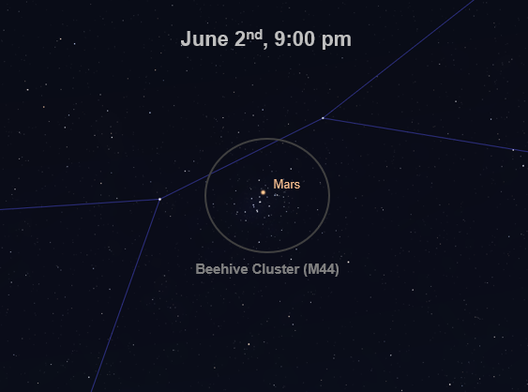
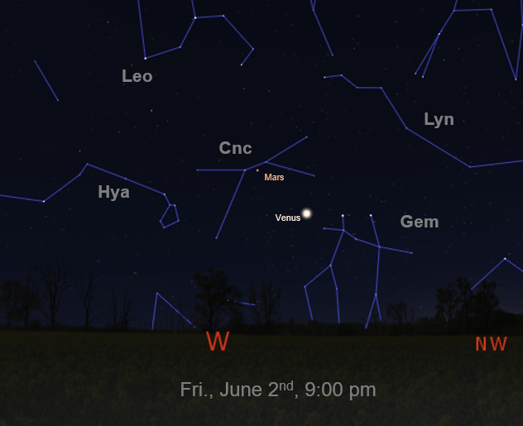
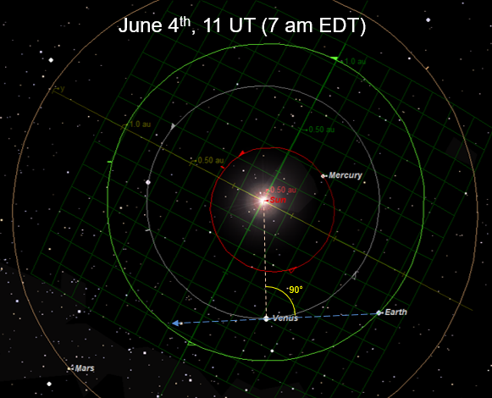
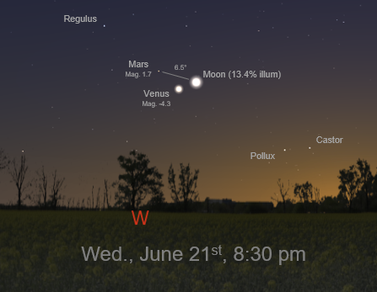
Celestial Events
June 2023
Fri., 2nd – View Mars nestled “within” the Beehive Cluster (M44) as dusk deepens around 9:00 pm.
Sun., 4th – Venus at easternmost elongation; 45.4° from the Sun in the evening sky; magnitude -4.3.
Wed., 14th – Earliest sunrise for the year, 5:57:15 am.
Wed., 21st – Summer Solstice, 10:58 a.m. EDT. Sun directly overhead at latitude 23.44° N. Most daylight hours for the year, 14 hrs 46 min 52 sec.
Wed., 21st – View the Slender crescent Moon, Venus and Mars within a 6.5° diameter circle around 8:30 pm as dusk deepens.
Wed., 28th – Latest sunset for the year, 8:45:49 pm.
For a great explanation of why the earliest sunrise and latest sunset are not on the solstice, go to: https://aa.usno.navy.mil/faq/rs_solstices#tech

Slide 5
N
June 1st, 9:55 p.m.
(30 min. before full darkness)
Little Dipper - UMi
Polaris
Big Dipper
UMa
Venus
E
Mars
W
Moon
S

Slide 6
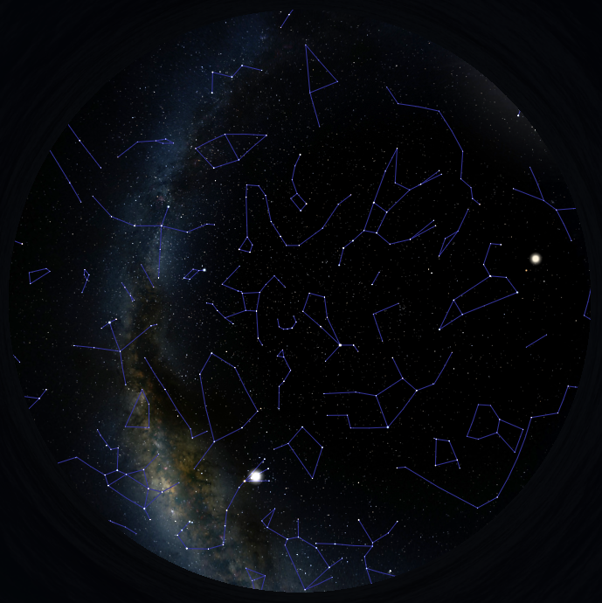
N
June 30th, 10:07 p.m.
(30 min. before full darkness)
Polaris
Venus
Mars
E
W
Moon
S

Slide 7
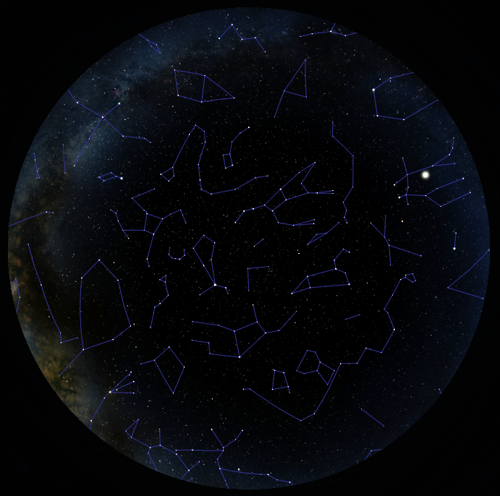
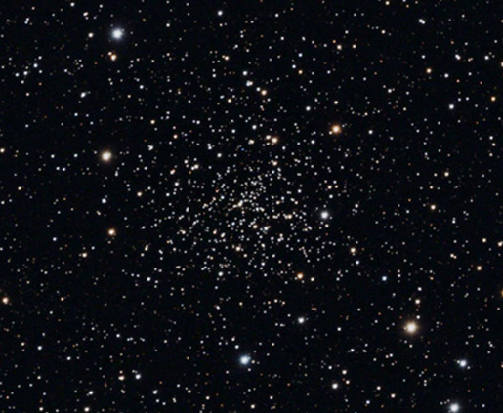
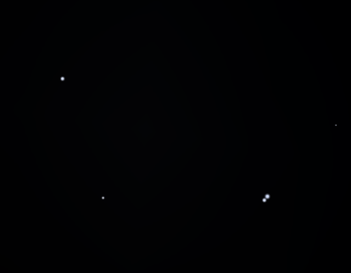
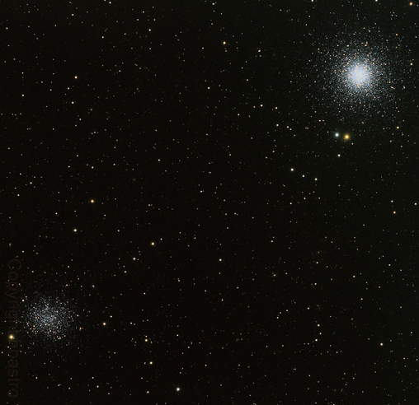
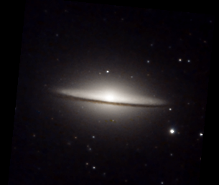
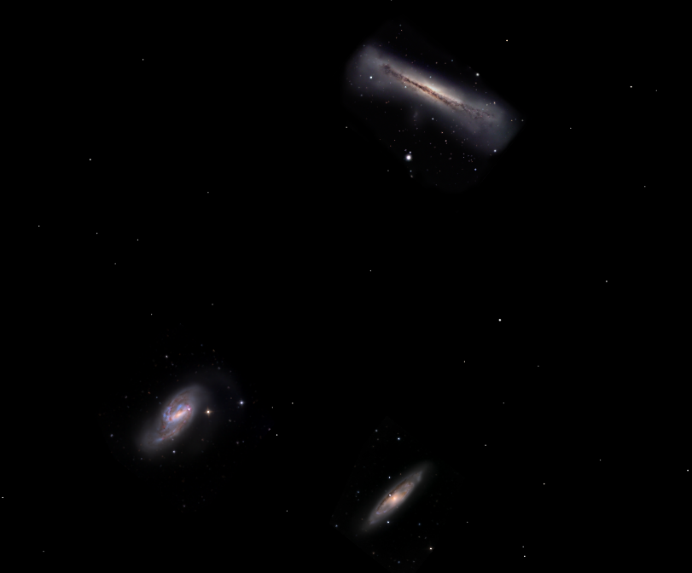
N
May 19th, 9:40 p.m.
30 min. before full darkness
Sunset – 8:25 pm
Moonset – 8:49 pm
NGC 188
Alcor
“Three Leaps of the Gazelle”
Venus
Mizar
Mars
E
W
M53
NGC 5053
M104 - The Sombrero
Leo Triplet
S

Slide 8
Questions
???

